Slide 1
Qualifying Exam
Jiawen Liu
Advised by: Marco Gaboardi

Slide 2
Content
Short Summary
Relations & Importance
Research

Slide 3
Short Summary – 8 paper
Statistical Analysis
[DMNS. 2006] – Calibrating Noise to Sensitivity in Private Data Analysis
[DFH+. 2015c] – preserving statistical validity in adaptive data analysis
[S. 2017] – Information Privacy and Stability in Adaptive Data Analysis
[JLN+. 2019] – new analysis on the differential privacy’s generalization
Programming Language
[XP. 1999] – dependent type in Practical programming
[BGGHS. 2016] – formally verify differential privacy via probabilistic coupling
[YGSBPA. 2017] – verifying the correctness and randomness of HMAC implementation
[NDA+. 2019] – high order language and linear type system for auto verifying the differential privacy
Notes:
these 8 papers land in 2 main areas, statical analysis , prolanguage languae.
1.
2.

Slide 4
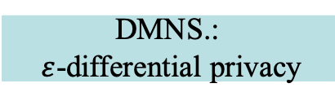
Relations & Importance
2019
2017
2016
2015
2013
2010
2006
1999
JLNRSS.
NDA+.
S.
YGSBPA.
BNSSSU.
BGGHS.
DFHPRR. [2015a,b]
DFHPRR. [15c]
GHHNP.: dFuzz
Applying dp in adaptive data analysis
RP.: Fuzz
Formally verifying differential privacy
DMNS.:
$ε$-differential privacy
Calibrating Noise to Sensitivity in Private Data Analysis
XP.
Notes:
Basic definitions or notations
Back up slides for definitions and notations
Keep track of the structures.

Slide 5
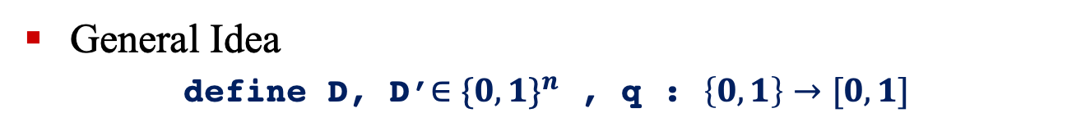
Calibrating Noise to Sensitivity in Private Data Analysis
General Idea
define D, D’$∈{\{0,1\}}^{n}$ , q : $\left\{0,1\right\}→[0, 1]$
D
D’
1
0
1
1
…
0
1
0
0
1
…
0
differ in 1 entry
indistinguishable
q(D)
q(D’)

Slide 6
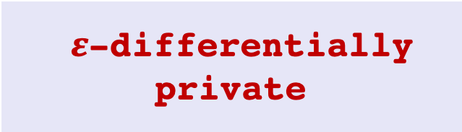

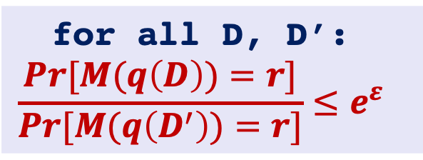
Calibrating Noise to Sensitivity in Private Data Analysis
for all D, D’:
$$\frac{Pr[M(q\left(D\right))=r]}{Pr[M(q\left(D^{′}\right))=r]}≤e^{ε}$$
Perturbed result r
Privacy loss
M Add noise calibrated to the query q’s sensitivity S(q)
D, D’ are a pair of data base differ in only 1 entry
Mechanism M is
The sensitivity:
for all D D’ differ in a single entry
$${\left\|q(D) – q(D’)\right\|}_{1} ≤S(q)$$
True result t
$ε$-differentially private
query q
Data base D

Slide 7
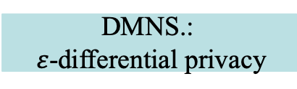
First Direction: Applying dp in adaptive data analysis
2019
2017
2016
2015
2013
2010
2006
1999
JLNRSS.
S.
BNSSSU.
DFHPRR. [2015a, b]
Preserving Statistical Validity in Adaptive Data Analysis
DFHPRR. [15c]
First Relevant Direction: Extend dp into adaptive data analysis
DMNS.:
$ε$-differential privacy

Slide 8
Preserving Statistical Validity in Adaptive Data Analysis
Data Analysis
approximate
population
data set
D
analysis result
Combination of multiple queries over D
sample
apply query on D
Data Analysis
Notes:
$q(S)$an empirical average of query q on S
q(P): the True expectation
q(S) is concentrated around q(P)
straightforward bound by applying existing work (stability and generalization) with the differential privacy definition.
bulk of this work is deriving high probability bounds on this generalization error.

Slide 9

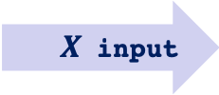



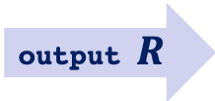
Preserving Statistical Validity in Adaptive Data Analysis
Adaptive Data Analysis
$X$ input
$${query}_{1} (X)$$
some queries rely on the results of other queries
$${query}_{2}( ,X)$$
$${query}_{3}( ,X)$$
…
$${query}_{k}( ,X)$$
output $R$
Notes:
$q(S)$an empirical average of query q on S
q(P): the True expectation
q(S) is concentrated around q(P)
straightforward bound by applying existing work (stability and generalization) with the differential privacy definition.
bulk of this work is deriving high probability bounds on this generalization error.

Slide 10





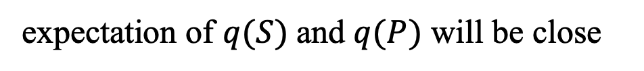

Preserving Statistical Validity in Adaptive Data Analysis
Transfer Theorem
Population
$$P$$
Dataset
$S$
$$\underset{←}{sample}$$
close
$$q(P)$$
$$q(S)$$
query q is generated by an $\left(ε, δ\right)$-differentially private algorithms
empirical average
true expectation
expectation of $q(S)$and $q(P)$ will be close
$$\left|𝔼\left(q\left(S\right)\right)−𝔼\left(q\left(P\right)\right)\right|≤ e^{ε} −1+ δ$$
Notes:
$q(S)$an empirical average of query q on S
q(P): the True expectation
q(S) is concentrated around q(P)
primitive results, a straightforward bound by applying existing work (stability and generalization) with the differential privacy definition.
bulk of this work is deriving high probability bounds on this generalization error.

Slide 11
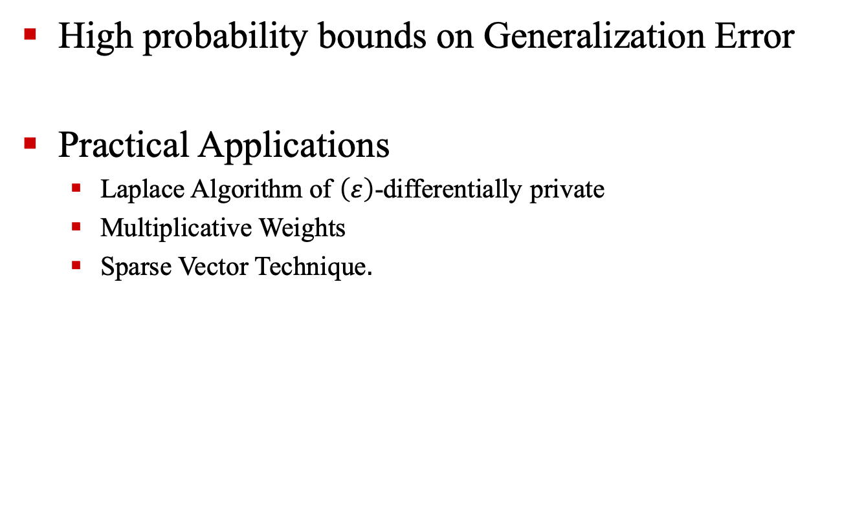
Preserving Statistical Validity in Adaptive Data Analysis
High probability bounds on Generalization Error
Practical Applications
Laplace Algorithm of $\left(ε\right)$-differentially private
Multiplicative Weights
Sparse Vector Technique$.$
Notes:
might be deleted from presentation, move to the technique slides

Slide 12
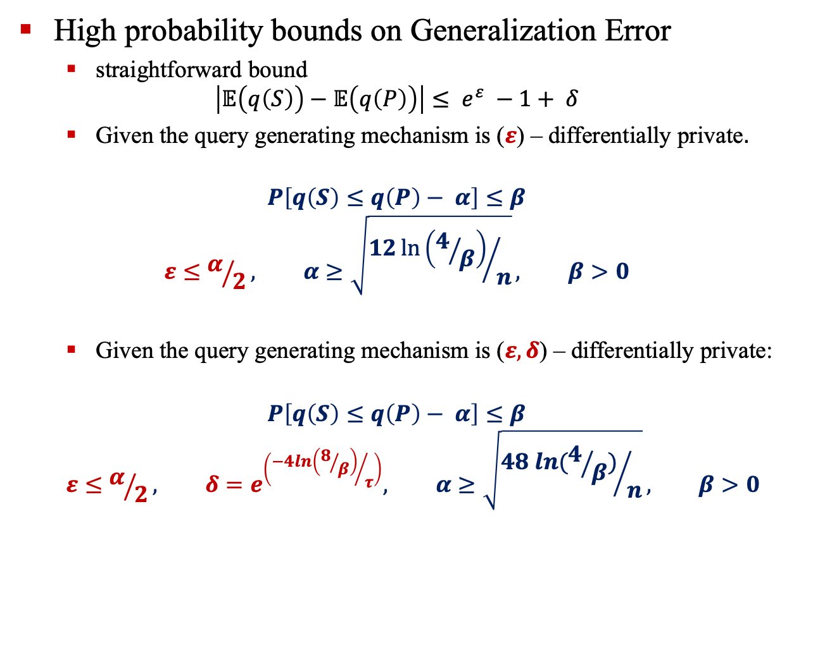
Preserving Statistical Validity in Adaptive Data Analysis
High probability bounds on Generalization Error
straightforward bound
$$\left|𝔼\left(q\left(S\right)\right)−𝔼\left(q\left(P\right)\right)\right|≤ e^{ε} −1+ δ$$
Given the query generating mechanism is ($ε$) – differentially private$.$
$$P\left[q\left(S\right)≤q\left(P\right)− α\right]≤β$$
$$ε≤α/2, α≥\sqrt{{12\ln\left(4/β\right)}/n}, β>0$$
Given the query generating mechanism is ($ε,δ$) – differentially private:
$$P\left[q\left(S\right)≤q\left(P\right)− α\right]≤β$$
$$ε≤α/2, δ=e^{\left({−4ln\left(8/β\right)}/τ\right)}, α≥\sqrt{{48 ln(4/β)}/n}, β>0$$
Notes:
might be deleted from presentation, move to the technique slides

Slide 13
Guaranteeing validity in adaptive data analysis
2019
2017
2016
2015
2013
2010
2006
1999
JLNRSS.
New proof for the Transfer Theorem by studying the posterior distribution:
sample accuracy
distributional accuracy
A better probabilistic bound on generalization error.
S.
BNSSSU.
DFHPRR. [2015a, b]
DFHPRR. [15c]
DMNS.:
$ε$-differential privacy

Slide 14


New analysis of differential privacy’s generalization Guarantee
Transfer Theorem – new proof
Population
P
Dataset
S
$$\underset{←}{sample}$$
close
$$q(S)$$
$$q(P)$$
close
sample accuracy
distributional accuracy on posterior
close
A better probability bound for $\left(ε, δ\right)$-differential privacy
Notes:
sample accuracy

Slide 15
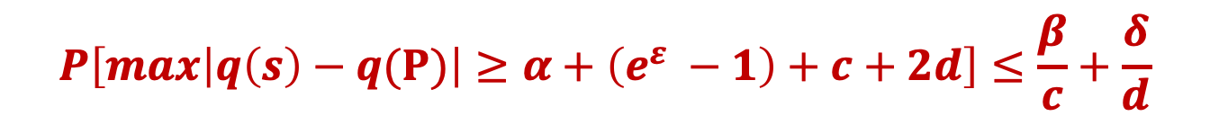
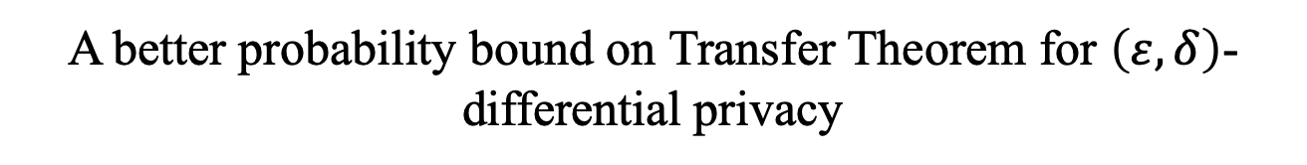
New analysis of differential privacy’s generalization Guarantee
Transfer Theorem – new proof
Population
P
Dataset
S
$$\underset{←}{sample}$$
sample accuracy
close
distributional accuracy on posterior
A better probability bound on Transfer Theorem for $\left(ε, δ\right)$-differential privacy
$$P\left[max\left|q\left(s\right)−q(Ρ)\right|≥α+\left(e^{ε} −1\right)+c+2d\right]≤\frac{β}{c}+\frac{δ}{d}$$

Slide 16
Guaranteeing validity in adaptive data analysis
2019
2017
2016
2015
2013
2010
2006
1999
JLNRSS.
Based on theory work in [DFH+15c]
Proposed the practical methods with validate generalization guarantee:
Thresholdout
SparseValidate
S.
BNSSSU.
DFHPRR. [2015a, b]
DFHPRR. [15c]
DMNS.:
$ε$-differential privacy
Notes:
- show how the differential-privacy based approach given in DFH+ 15c is applicable much more broadly to adaptive data analysis - also showed approach based on description length can also be used to give guarantees of statistical validity in adaptive settings.
- demonstrate that these incomparable approaches can be unified via the notion of approximate max-information

Slide 17
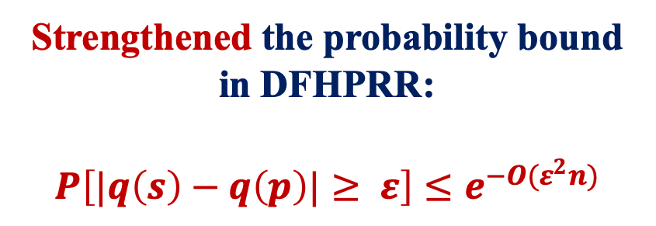
Guaranteeing validity in adaptive data analysis
2019
2017
2016
2015
2013
2010
2006
1999
JLNRSS.
S.
Strengthened the probability bound in DFHPRR:
$$P\left[|q\left(s\right)−q\left(p\right)|≥ ε\right]≤e^{−O(ε^{2}n)}$$
BNSSSU.
DFHPRR. [2015a, b]
DFHPRR. [15c]
DMNS.:
$ε$-differential privacy

Slide 18
Guaranteeing validity in adaptive data analysis
2019
2017
2016
2015
2013
2010
2006
1999
JLNRSS.
S.
A survey on existing researches of generalization error in adaptive data analysis.
BNSSSU.
DFHPRR. [2015a, b]
DFHPRR. [15c]
DMNS.:
$ε$-differential privacy

Slide 19
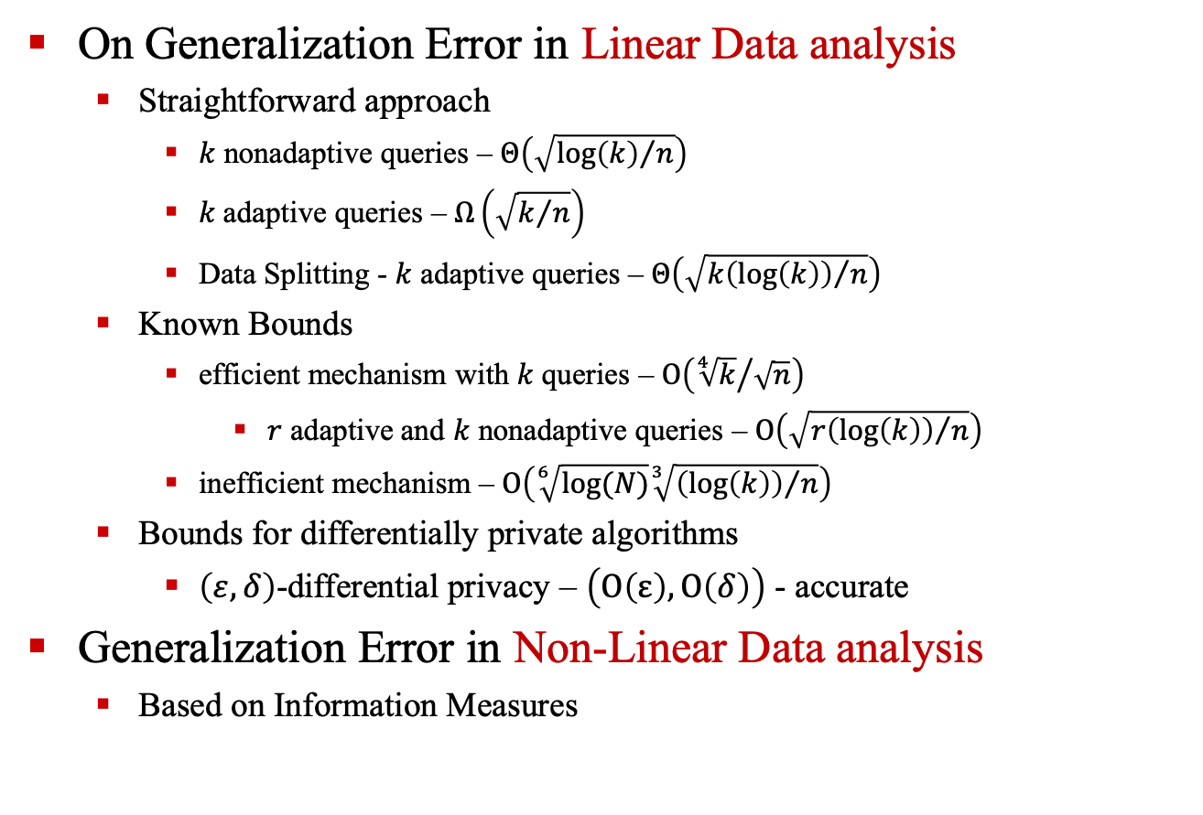
Information Privacy and Stability in Adaptive Data Analysis
On Generalization Error in Linear Data analysis
Straightforward approach
$k$ nonadaptive queries – $Θ\left(\sqrt{{\log\left(k\right)}/n}\right)$
$k$ adaptive queries – $Ω\left(\sqrt{k/n}\right)$
Data Splitting - $k$ adaptive queries – $Θ\left(\sqrt{{k\left(\log\left(k\right)\right)}/n}\right)$
Known Bounds
efficient mechanism with $k$ queries – $Ο\left({\sqrt[4]{k}}/{\sqrt{n}}\right)$
$r$ adaptive and $k$ nonadaptive queries – $Ο\left(\sqrt{{r\left(\log\left(k\right)\right)}/n}\right)$
inefficient mechanism – $Ο\left(\sqrt[6]{log⁡(N)}\sqrt[3]{{\left(\log\left(k\right)\right)}/n}\right)$
Bounds for differentially private algorithms
$\left(ε, δ\right)$-differential privacy – $\left(Ο\left(ε\right),Ο\left(δ\right)\right)$ - accurate
Generalization Error in Non-Linear Data analysis
Based on Information Measures
Notes:
might be deleted from presentation, move to the technique slides

Slide 20
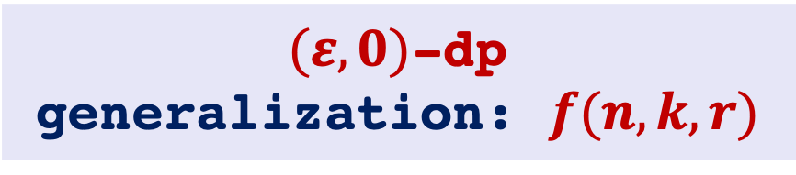
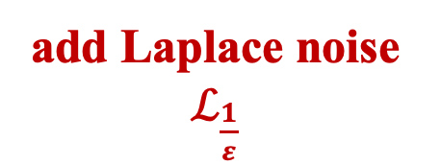
Simple Example
$(ε,0)$-dp
generalization: $f(n, k, r)$
input:
data set
Theory proofs
def prog x =
def q x = x
return q(x)+Lap
?
program
counting query
add Laplace noise $ℒ_{\frac{1}{ε}}$

Slide 21
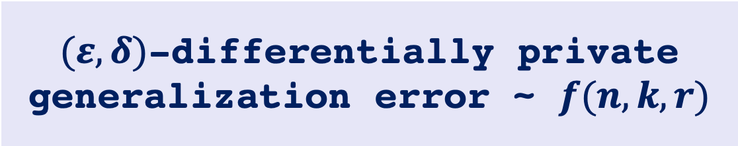
Consideration
$(ε,δ)$-differentially private
generalization error ~ $f(n, k, r)$
Formal verification
Theory proofs
?
Algorithms
implementation
Programs

Slide 22
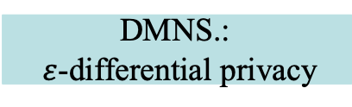

Second Direction: Formal Verification of differential privacy
2019
2017
2016
2015
2013
2010
2006
1999
NDA+.
Based on Mini-ML, Enriched by :
Index objects from Constraint Domains: constraints: C
$I$ndex objects$:a\left| ()\right| (i, j)|…$
Index sort$: γ$ ::= b| $γ$* $γ$|{a: $γ$|P}|…
Index propositions: P
Universal Dependent Types $τ$: $Πa: γ. τ$
Existential Dependent Types $τ$ $Σa: γ. τ$
YGSBPA.
BGGHS.
GHHNP.: dFuzz
RP.: Fuzz
Second Relevant Direction: Formal Verification of differential privacy
DMNS.:
$ε$-differential privacy
XP.

Slide 23
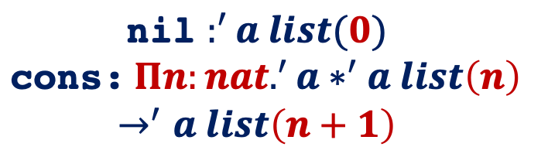
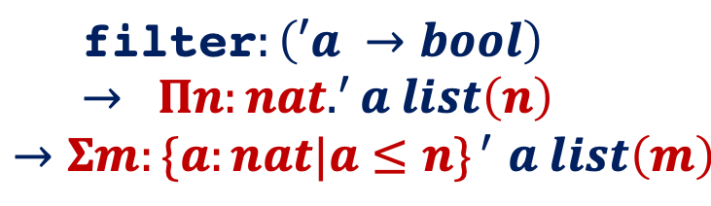
Dependent Types in Practical Programming
Simple Example:
index object
universal dependent type
‘a list =
|nil
|cons of ‘a*‘a list
$\text{nil}$ $:^{′}a list(0)$
$$\text{cons}\text{:} Πn:nat.^{′}a∗^{′}a list\left(n\right)$$
$$→^{′}a list\left(n+1\right)$$
fun filter p nil = nil
| filter p (x::xs) =
if p(x) then x::(filter p xs)
else (filter p xs)
universal dependent type
index object
existential dependent type
$$\text{filter}:\left(′a →bool\right)→ Πn:nat.^{′}a list\left(n\right)$$
$${→Σm:\{a:nat|a≤n\}}^{ ′}a list\left(m\right)$$
Notes:
technique

Slide 24
Formal Verification of differential privacy
2019
2017
2016
2015
2013
2010
2006
1999
Linear Dependent Type System
NDA+.
YGSBPA.
+
BGGHS.
Probability monad
Enforcing program’s differential privacy by tracking its sensitivity
GHHNP.: dFuzz
RP.: Fuzz
DMNS.:
$ε$-differential privacy
XP.
Notes:
Sensitivity in principle having the same meaning as before
The privacy loss can be constructed from the

Slide 25
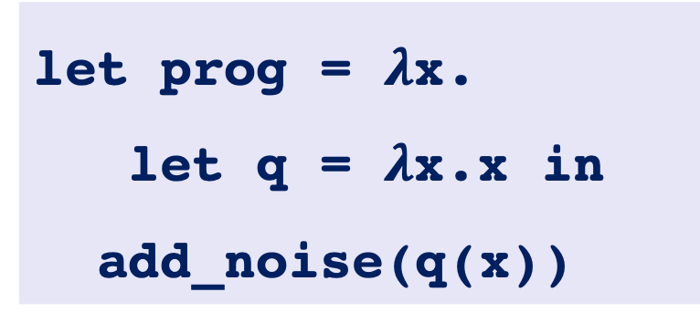



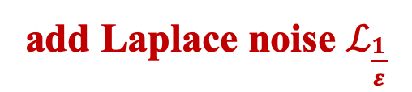
Simple Example
monadic type
for random computing
input:
data set
counting query
linear type
for 1 sensitivity function
let prog = $λ$x.
let q = $λ$x.x in
add_noise(q(x))
$\text{add}\text{_}\text{noise}$ $: ℝ⊸ ∘ℝ$
prog $:row⊸ ∘ℝ$
q $:row⊸ ℝ$
add Laplace noise $ℒ_{\frac{1}{ε}}$
Notes:
this sensitivity is what we show before
The differential privacy is constructed by selecting a specific metric and then tracking function’s sensitivity, where sensitivity 1 function will equivalent to a differentially private function under the specific metric.

Slide 26

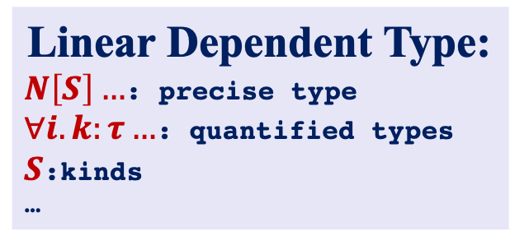
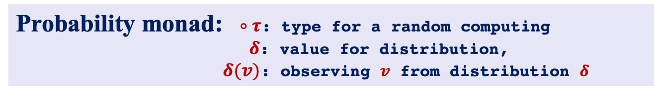
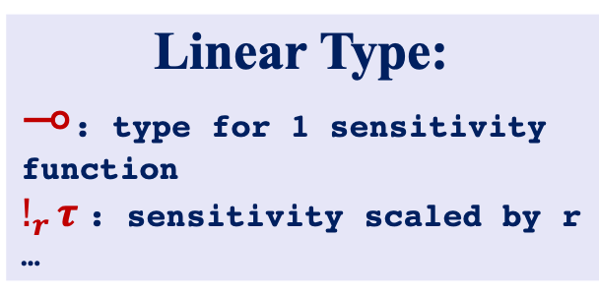
Fuzz vs. DFuzz
Type system design
Fuzz
DFuzz:
Linear Type:
$⊸$: type for 1 sensitivity function
$!_{r}τ$: sensitivity scaled by r
…
Linear Dependent Type:
$N\left[S\right]…$: precise type
$∀i. k:τ…$: quantified types
$S$:kinds
…
vs.
Probability monad: $∘τ$: type for a random computing
$δ$: value for distribution,
$δ(v)$: observing $v$ from distribution $δ$
Use appropriate distance metric to enforce the differential privacy
$$d\left(δ,δ′\right)= \frac{1}{ε}\left(max\left(\left|\ln\left(\frac{δ\left(x\right)}{δ^{′}\left(x\right)}\right)\right|\right)\right)$$
Notes:
technique

Slide 27
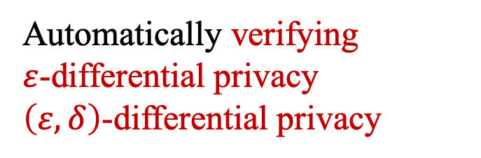
Formal Verification of differential privacy
2019
2017
2016
2015
2013
2010
2006
1999
NDA+.
Sensitivity language
YGSBPA.
+
BGGHS.
Privacy language
Automatically verifying
$ε$-differential privacy
$\left(ε, δ\right)$-differential privacy
GHHNP.: dFuzz
RP.: Fuzz
DMNS.:
$ε$-differential privacy
XP.

Slide 28



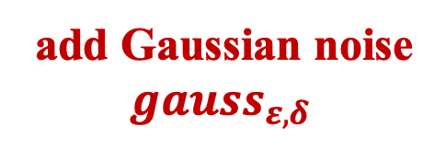
Simple Example – privacy loss can’t be tracked in Fuzz
linear type (Fuzz)
for r sensitivity function
in the sensitivity language
input:
data set
query
let prog = $λ$x.
let q = $λ$x.x in
${gauss}_{\left(ε,δ\right)}$(q(x))
q $:row⊸_{1} ℝ$
$${gauss}_{ε,δ }:ℝ@<ε, δ> ⊸^{∗} ℝ$$
strictly 1-sensitivity in privacy language
track the privacy loss in privacy language
add Gaussian noise ${gauss}_{ε,δ }$
Notes:
unable to type epsilon, delta differential privacy

Slide 29
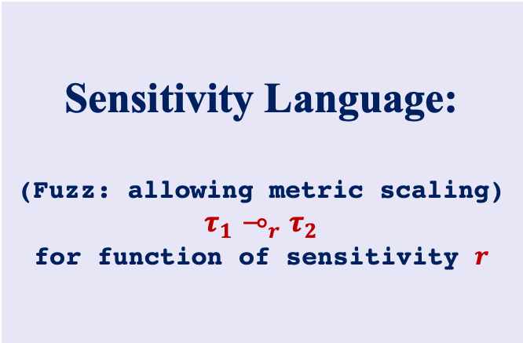
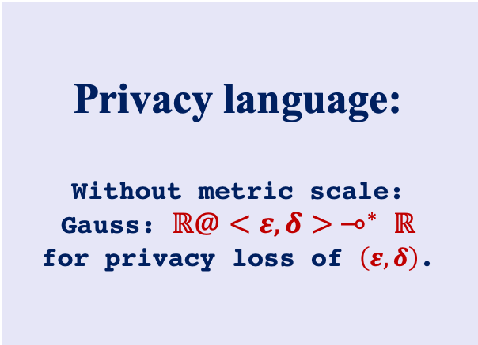
Duet: An Expressive Higher-Order Language and Linear Type System for statically Enforcing Differential Privacy
Type system design
Sensitivity Language:
(Fuzz: allowing metric scaling)
$$τ_{1}⊸_{r}τ_{2}$$
for function of sensitivity $r$
Privacy language:
Without metric scale:
Gauss: $ℝ@<ε, δ> ⊸^{∗} ℝ$
for privacy loss of $\left(ε, δ\right)$.
Track the sensitivity and privacy cost separately
Notes:
technique details

Slide 30
Formal Verification of differential privacy
2019
2017
2016
2015
2013
2010
2006
1999
NDA+.
YGSBPA.
BGGHS.
A relational programming logic combining with probabilistic couplings and liftings.
GHHNP.: dFuzz
RP.: Fuzz
DMNS.:
$ε$-differential privacy
XP.

Slide 31
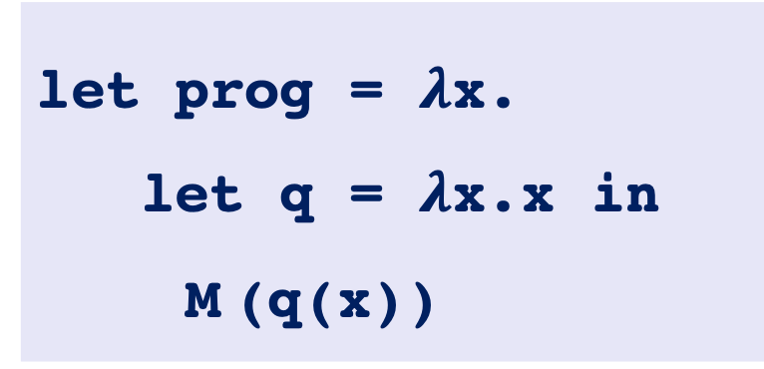
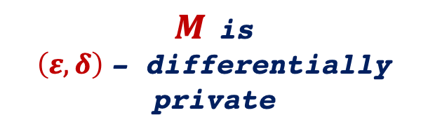

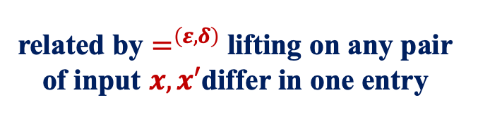

Simple Example
related by $=^{\left(ε, δ\right)}$ lifting on any pair of input $x, x′$differ in one entry
let prog = $λ$x.
let q = $λ$x.x in
M (q(x))
$$M\left(q(x)\right) =^{\left(ε, δ\right)}M\left(q(x′)\right)$$
$$⟺$$
$M$ is
$\left(ε, δ\right)$- differentially private
applying unknown mechanism M
Notes:
unable to type epsilon, delta differential privacy

Slide 32
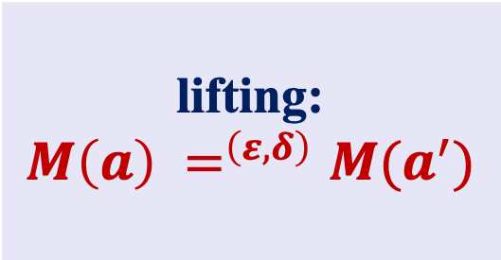

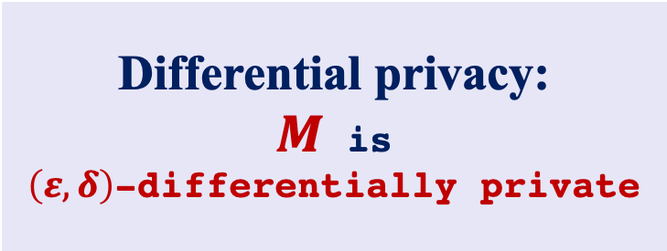
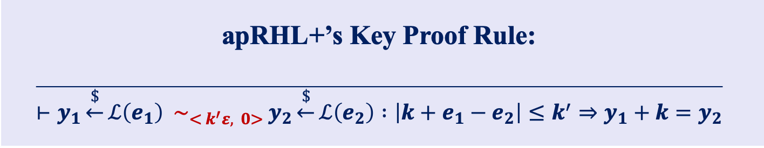
Proving Differential privacy via probabilistic coupling
Concept of coupling
lifting:
$$M\left(a\right) =^{\left(ε, δ\right)}M(a^{′})$$
Differential privacy:
$M$ is
$\left(ε, δ\right)$-differentially private
$$⟺$$
apRHL+’s Key Proof Rule:
$$\overline{⊢y_{1}\underset{←}{\$}ℒ\left(e_{1}\right) \sim _{{< k}^{′}ε, 0>} y_{2}\underset{←}{\$}ℒ\left(e_{2}\right) :\left|k+e_{1}−e_{2}\right|≤k^{′}⇒y_{1}+k=y_{2}}$$

Slide 33
Formal Verification of differential privacy
2019
2017
2016
2015
2013
2010
2006
1999
NDA+.
1. Formalizing the proof of DRBG
2. Formally verified the correctness and randomness of mbedTLS implementation of HMAC-DRBG in Coq.
YGSBPA.
BGGHS.
Construct the proof:
DRBG = {Instantiate, Update, Reseed, generate)…}
proof: DRBG1 ~ DRBG2
GHHNP.: dFuzz
RP.: Fuzz
Mechanized in Coq
DMNS.:
$ε$-differential privacy
XP.

Slide 34
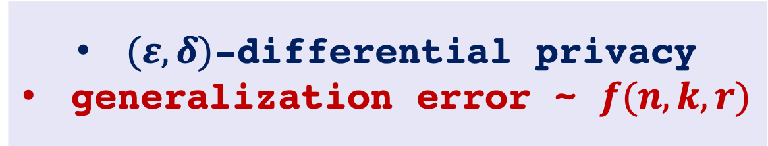
Consideration 1:
$(ε,δ)$-differential privacy
generalization error ~ $f(n, k, r)$
Formal verification
Theory proofs
Algorithms
implementation
Programs

Slide 35

Consideration 2:
$ε/(ε, δ)$-differentially private
?
Formal verification
Formally verifying Snapping Mechanism[1]
Realistic program with floating point error
Ideal program
implementation
Differentially Private Algorithms
[1] Mironov, Ilya, On Significance of the Least Significant Bits For Differential Privacy, CCS 2012

Slide 36

Possible Research Directions
Formally verifying the realistic implementation of dp-algorithms: snapping mechanism
formal verification of the program’s statistical validity.
Guaranteeing validity in adaptive data analysis
Formally verifying differential privacy
2019
2017
2016
2015
2013
2010
2006
1999
JLNRSS.
NDA+.
Adam Smith.
YGSBPA.
BNSSSU.
BGGHS.
DFHPRR. [2015a]
[2015b]
DFHPRR. [15c]
GHHNP.: dFuzz
Reed and Pierce: Fuzz
DMNS.: $ε$-differential privacy
Xi and Pfenning

Slide 37
Formal verification of the program’s statistical validity.
Research Goals. [DFHPRR.’15, Adam Smith’17, JLNRSS.’19…]
Guaranteeing the generalization error for implementations of adaptive data analysis.
Helping programmer to optimize their programs to have better generalizations.
Challenges.
Figuring out the program’s adaptive query numbers, i.e. the program’s adaptivity.
Methodologies. [Xi and Pfenning ‘99 , NDA+’19, …]
Designing a dependent type system and language that

Slide 38
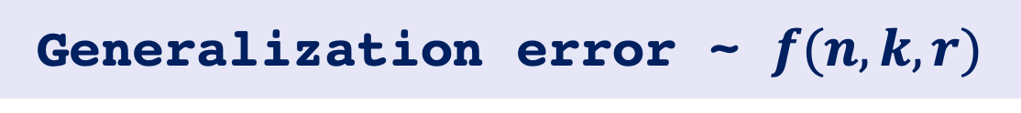
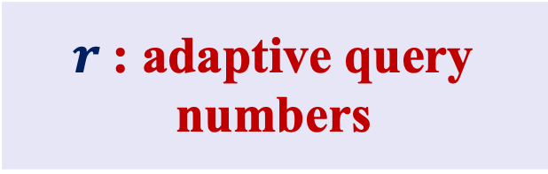
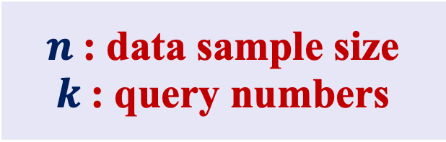
Research Goals &. Challenge
Generalization error ~ $f(n, k, r)$
Easy to Track
Challenge
$n$: data sample size
$k$: query numbers
$r$: adaptive query numbers

Slide 39






Research Goals &. Challenge
input
$${query}_{1} (X)$$
$$X$$
$${query}_{2}( ,X)$$
k adaptive query numbers
$${query}_{3}( ,X)$$
…
$${query}_{k}( ,X)$$
output
$$R$$

Slide 40
Methodologies – System Overview
prog
type system
adaptivity
depth
input
output

Slide 41
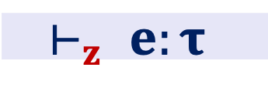
Methodologies – Language Design
Refinement Types [XP ’99]
Helping programmer to optimize their programs to have better generalizations.
Expressions.[DLG ’11…]
Figuring out the program’s adaptive query numbers, i.e. the program’s adaptivity.
Typing Judgement. [DLG ’11…]
approximates an upper bound on adaptive query numbers
$$⊢_{z} e:τ$$
upper bound of adaptive query numbers
Ugo Dal Lago and Marco Gaboardi, Linear Dependent Types and Relative Completeness, LICS, 2011

Slide 42

Sample Example:
input:
data set
let prog = $λ$x.
let q = $λ$x.x in
Mech(q(x))
query
input
type system
Gaussian Mechanism
Laplace Mechanism
Threshold out
…
output
adaptivity
1

Slide 43
Possible Research Directions
Formally verifying the realistic implementation of dp-algorithms: snapping mechanism
formal verification of the program’s statistical validity.
Guaranteeing validity in adaptive data analysis
Formally verifying differential privacy
2019
2017
2016
2015
2013
2010
2006
1999
JLNRSS.
NDA+.
Adam Smith.
YGSBPA.
BNSSSU.
GGM+
BGGHS.
DFHPRR. [2015a]
[2015b]
DFHPRR. [15c]
GHHNP.: dFuzz
Reed and Pierce: Fuzz
DMNS.: $ε$-differential privacy
Xi and Pfenning

Slide 44
Formal verification of differential privacy (snapping mechanism)
Research Goals. [Ilya Mironov ’12…]
Verifying the actual privacy loss for the realistic implementations of differentially private algorithms
Challenges. [Ilya Mironov ’12…]
Keep track of the floating point error
Generate the actual privacy loss given the floating point error
Methodologies. [NDA+.’19, BGGHS.’16, YGSBPA.’17…]
Design verification system based on the logic of probabilistic coupling and proof techniques in Coq.
[1] Mironov, Ilya, On Significance of the Least Significant Bits For Differential Privacy, CCS 2012

Slide 45
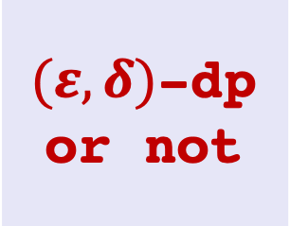
Methodologies
prog:
floating point implementation
input
Programming logic
output
$(ε, δ)$-dp or not

Slide 46
Thanks!

